Slide 1
Social-Media-
Tricks

Slide 2
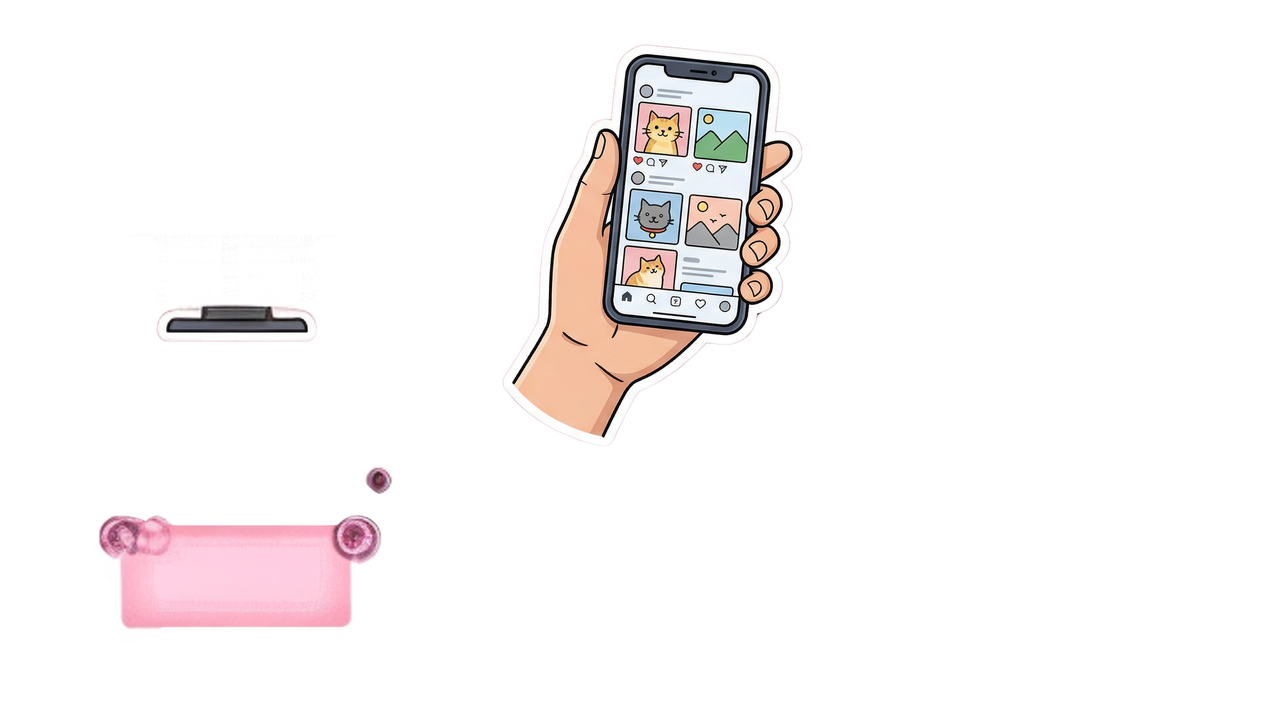
Endless-Scrolling

Slide 3
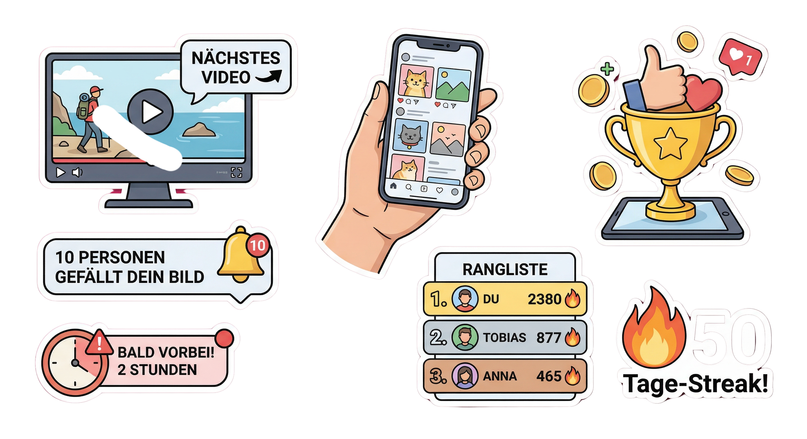
Likes

Slide 4
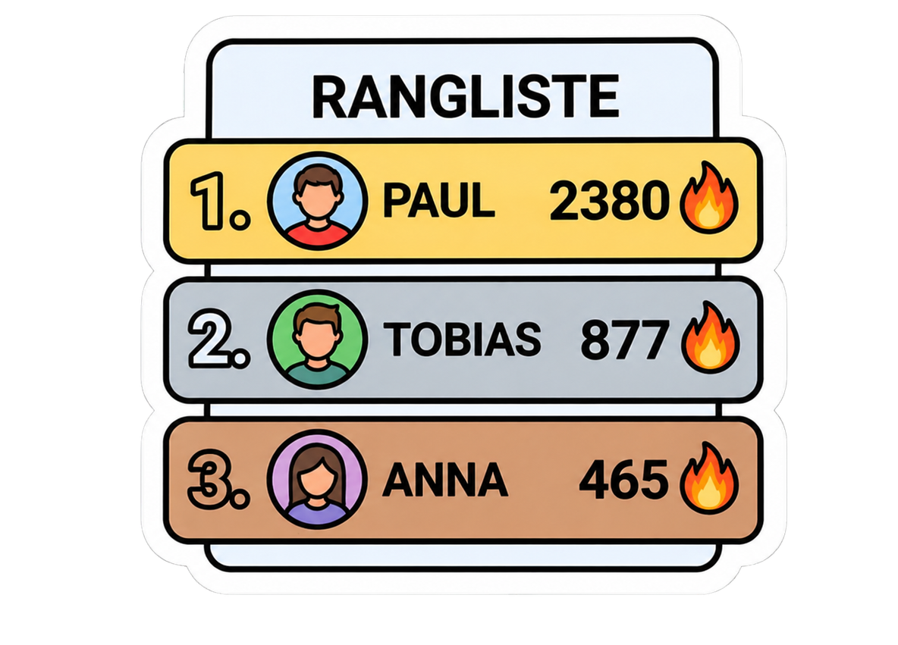
Streaks

